Slide 1
CCE201: Solid State Electronic Devices
EEC223: Electronics (1)
Lecture 04: Diodes
Prepared By
Dr. Eng. Sherif Hekal
Assistant Professor, CCE department

Slide 2
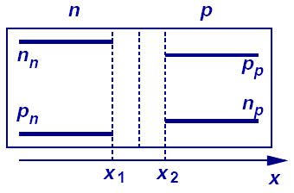
Report 01 – Sol.
Prove that the built-in potential across the PN junction is given by
Solution: when no voltage applied and at equilibrium, no current flows and we have
Note:

Slide 3
Introduction
In this Lecture we will learn
the characteristics of the ideal diode and how to analyze and design circuits containing multiple ideal diodes together with resistors and dc sources
the i-v characteristic of the junction diode and how to use it to analyze diode circuits operating in the various bias regions: forward, reverse, and breakdown
a simple but effective model of the diode i-v characteristic in the forward direction: the constant-voltage-drop model

Slide 4
Introduction
a powerful technique for the application and modeling of the diode (and in later chapters, transistors): dc-biasing the diode and modeling its operation for small signals around the dc-operating point by means of the small-signal model
the use of a string of forward-biased diodes and of diodes operating in the breakdown region (zener diodes), to provide constant dc voltages (voltage regulators)
application of the diode in the design of rectifier circuits, which convert ac voltages to dc as needed for powering electronic equipment
a number of other practical and important applications

Slide 5
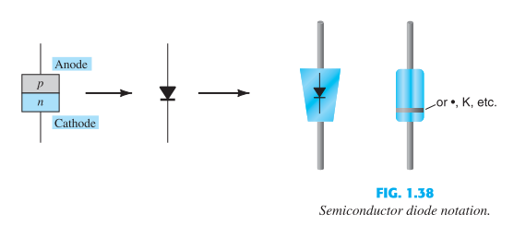
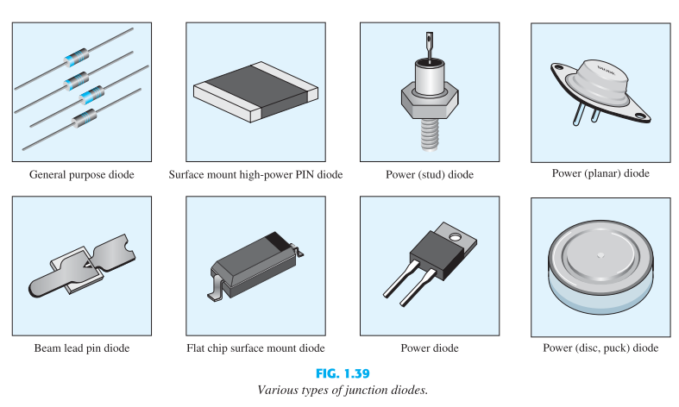
Introduction
Semiconductor Diode Notation
Various types of junction diodes

Slide 6
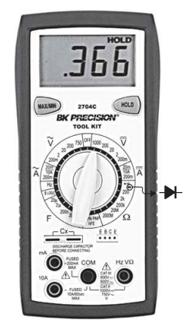
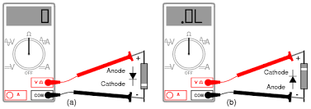
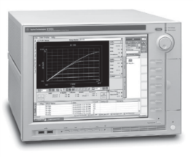
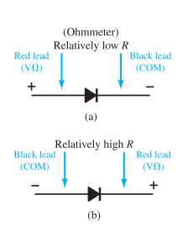
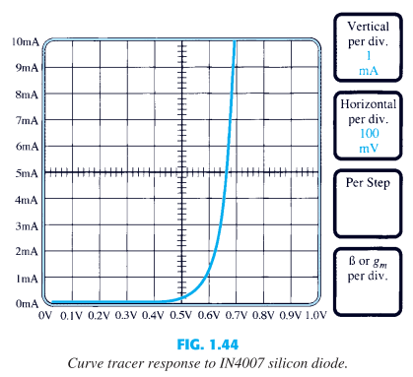
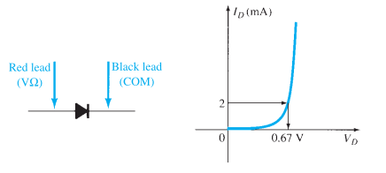
Diode Testing
Diode Checking Function
Ohmmeter Testing
Curve Tracer

Slide 7
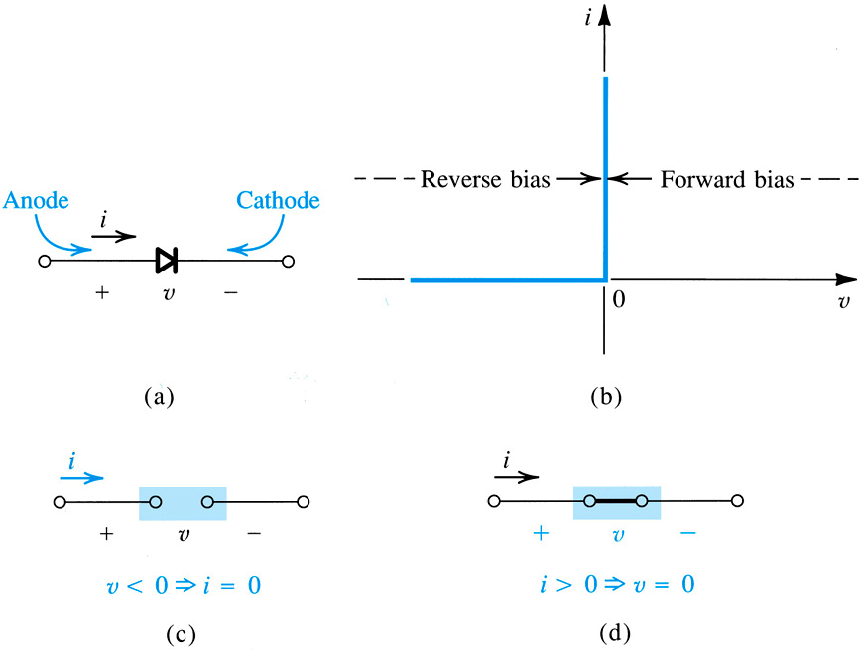
4.1.1. Current-Voltage Characteristic of the Ideal Diode
ideal diode – most fundament nonlinear circuit element
two terminal device
circuit symbol shown to right
operates in two modes
on and off
Figure 4.1: Diode characteristics

Slide 8
4.1.1. Current-Voltage Characteristic
cathode – negative terminal, from which current flows
anode – positive terminal of diode, into which current flows
voltage-current (VI) behavior is:
nonlinear curve consists of straight-line segments and it is called piecewise linear.
Notes:
the i–v characteristic of the ideal diode is highly nonlinear; although it consists of two straight-line segments, they are at 90° to one another. A nonlinear curve that consists of straight-line segments is said to be piecewise
linear.
Since this is your first exposure to a nonlinear device:
You can model a diode as piecewise linear.
When forward biased – it is a battery (about 0.6 v) in series with a resistance (the slope of the V-I curve).
When reverse biased it is a small constant current source (up to the reverse breakdown voltage = Zener).
When in reverse breakdown again modeled as a battery (The Zener voltage) in series with a small resistance as in the forward direction.

Slide 9
4.1.1: Current-Voltage Characteristic of the Ideal Diode
4.1.1. Current-Voltage Characteristic
mode #2: reverse bias = open ckt.
mode #1: forward bias = short ckt
ideal diode: is most fundament nonlinear circuit element
two terminal device with circuit symbol to right
operates in two modes forward and reverse bias
device symbol with two nodes
figure 4.1.
Notes:
The “Cathode” is marked on the diode by a stripe near that terminal.

Slide 10
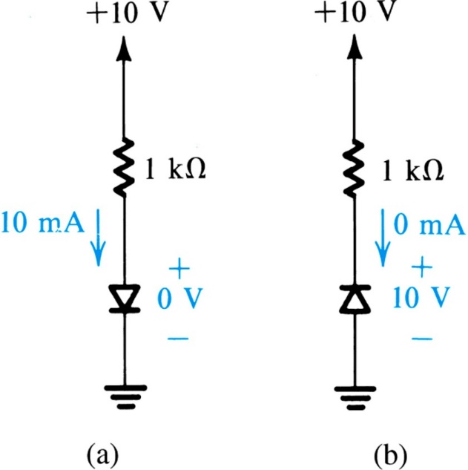
4.1.1. Current-Voltage Characteristic
External circuit should be designed to limit…
current flow across conducting diode
voltage across blocking diode
Examples are shown to right…
Figure 4.2: The two modes of operation of ideal diodes and the use of an external circuit to limit (a) the forward current and (b) the reverse voltage.
Notes:
From the above description it should be noted that the external circuit must be designed to limit the forward current through a conducting diode, and the reverse voltage across a cutoff diode, to predetermined values.

Slide 11
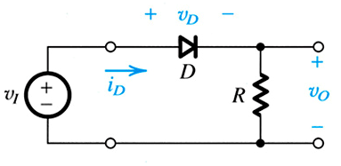
4.1.2: A Simple Application – The Rectifier
One fundamental application of this piecewise linear behavior is the rectifier.
Q: What is a rectifier?
A: Circuit which converts AC waves in to DC…ideally with no loss.
Figure 4.3(a): Rectifier Circuit
Notes:
Of course there is always some loss.

Slide 12
4.1.2: A Simple Application – The Rectifier
This circuit is composed of diode and series resistor.
Q: How does this circuit operate?
A: The diode blocks reverse current flow, preventing negative voltage across R.
Figure 4.3(a): Rectifier Circuit

Slide 13
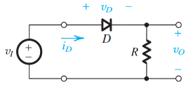
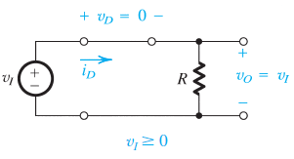
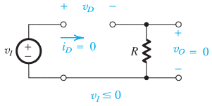
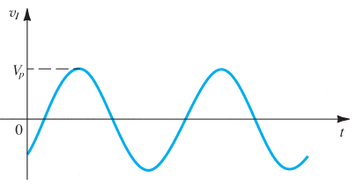
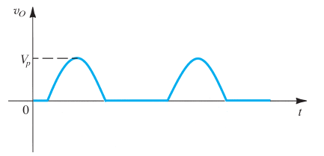
4.1.2: A Simple Application – The Rectifier
(a)
(b)
(c)
Input waveform
Output waveform.
(d)
(e)

Slide 14
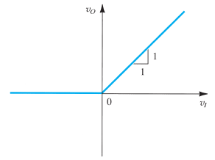
EXERCISE 4.1
For the circuit in Fig. 4.3(a), sketch the transfer characteristic v_{O} versus v_{I}.

Slide 15
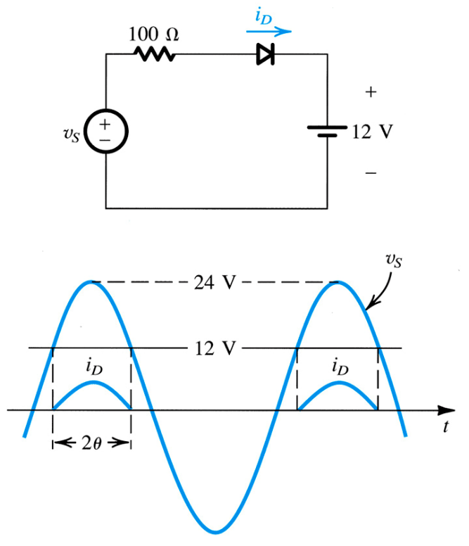
Example 4.1: Diode Rectifier
Consider the circuit of Figure 4.4. A source (v_{S}) with peak amplitude of 24V is employed to charge a 12V dc-battery.
Q(a): Find the fraction of each cycle during which the diode conducts.
Q(b): Find peak value of diode current and maximum reverse-bias voltage that appears across the diode.
Figure 4.4: Circuit and Waveforms for Example 4.1.

Slide 16
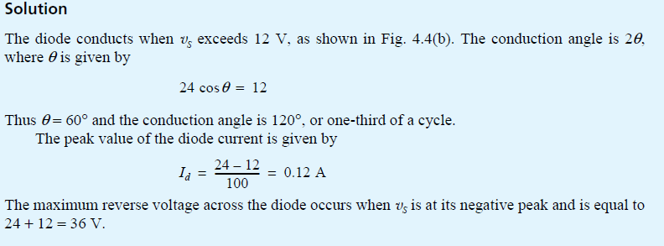
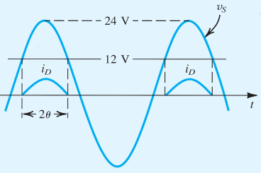
Example 4.1: Diode Rectifier
$$or 24\sin\left(30\right)=12$$
$$30$$
$$90$$

Slide 17
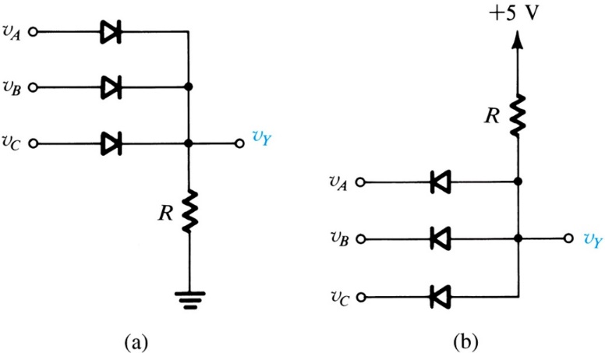
4.1.3. Another Application, Diode Logic Gates
Q: How may diodes be used to create logic gates?
A: Examples of AND / OR gates are shown right.
Refer to next slide.
Figure 4.5: Diode logic gates: (a) OR gate; (b) AND gate (in a positive-logic system).
Notes:
This is Resistor-Diode-Logic, but is generally never used due to practical reasons. The earliest computers used Resistor-Transistor-Logic (RTL) or Diode-Transistor-Logic (DTL).

Slide 18
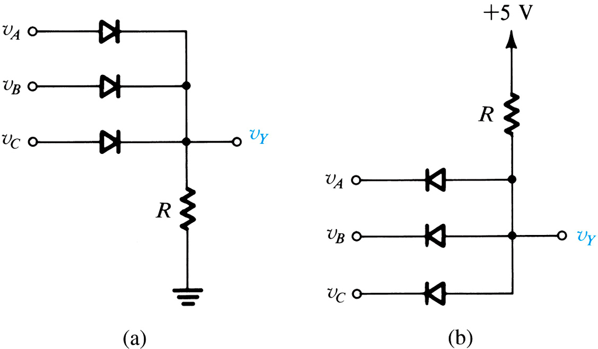
OR GATE
AND GATE
IF v_{A} = 5V THEN diode_{A} will conduct AND v_{Y} = v_{A} = 5V
IF v_{A} = 0V THEN diode_{A} will conduct AND v_{Y} = v_{A} = 0V
IF all diodes block THEN v_{Y} = 5V
+ 5V -
+ 5V-
IF any diode conducts THEN v_{Y} = 5V

Slide 19
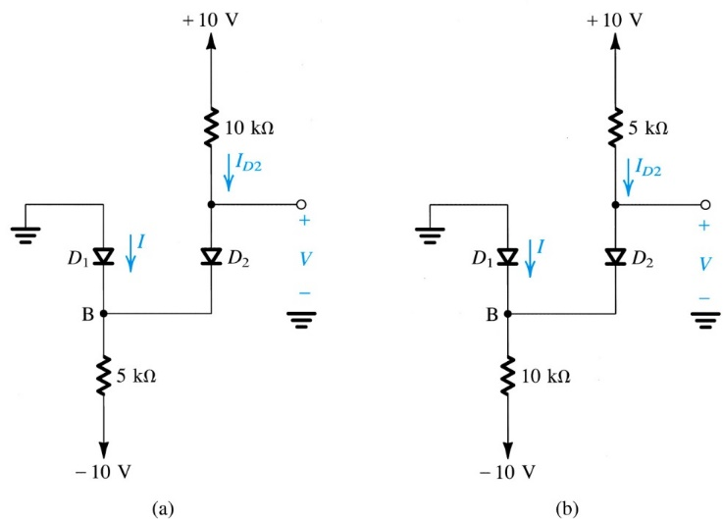
Example 4.2: More Diodes
To apply nodal / mesh techniques, one must have knowledge of all component impedances.
Q: What difficulties are associated with multi-diode circuits?
A: Circuit cannot be solved without knowledge of diodes’ statuses. Yet, statuses are dependent on the solution.
Figure 4.4: Circuit and Waveforms for Example 4.1.
Figure 4.6: Circuits for Example 4.2.
IF v_{B} < 0 THEN Z_{D1} = 0ohms ELSE Z_{D1} = open circuit

Slide 20
Example 4.2: More Diodes
Q: How does one solve these circuits?
A: One must use the following steps…
1) assume the status of all diodes
2) solve via mesh / nodal analysis
3) check for coherence
Notes:
Assume, then test the assumption to see if it works. Repeat.

Slide 21
Example 4.2: More Diodes
If answer to either of these is no, then the solution is not physically realizable.
Q: How does one check for coherence?
A: One must ask the following questions…
1) Are calculated voltages across all “assumed conducting” diodes forward-biased?
2) Are the calculated currents through all “assumed blocking” diodes zero?
Q: What does one do, if the solution is not coherent?
A: One must change one or more of these assumptions and solve as well as check for coherence again.

Slide 22
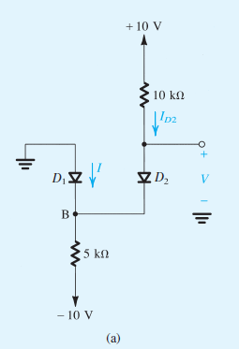
Example 4.2 – Sol.
For the circuit in Fig. 4.6(a), we shall assume that both diodes are conducting. It follows that V_{B} = 0 and V = 0. The current through D₂ can now be determined from
Writing a node equation at B,
results in I = 1 mA. Thus D₁ is conducting as originally assumed, and the final result is I = 1 mA and V = 0 V.

Slide 23
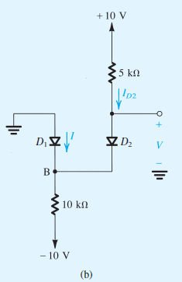
Example 4.2 – Sol.
For the circuit in Fig. 4.6(b), if we assume that both diodes are conducting, then V_{B} = 0 and V = 0. The current in D₂ is obtained from
The node equation at B is
which yields I = −1 mA. Since this is not possible, our original assumption is not correct. We start again, assuming that D₁ is off and D₂ is on. The current I_{D2} is given by
and the voltage at node B is
Thus D₁ is reverse biased as assumed, and the final result is I = 0 and V = 3.3 V.

Slide 24
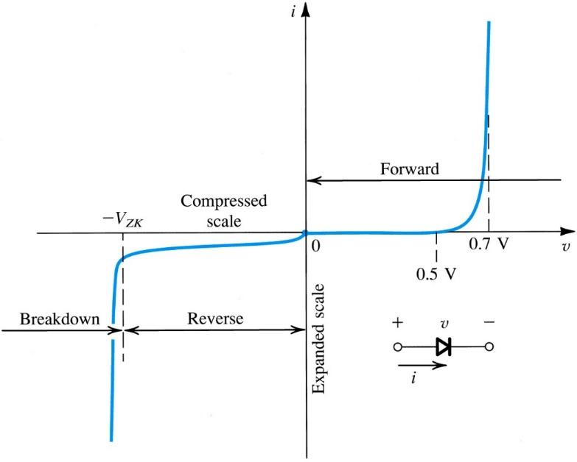
4.2. Terminal Characteristics of Junction Diodes
Most common implementation of a diode utilizes pn junction.
I-V curve consists of three characteristic regions
forward bias: v > 0
reverse bias: v < 0
breakdown: v < $−V_{ZK}$

Slide 25
4.2.1. The Forward-Bias Region
The forward-bias region of operation is entered when v > 0.
I-V relationship is closely approximated by equations to right.
(4.3) is a simplification suitable for large v
Notes:
Another name for IS , and one that we will occasionally use, is the scale current. This name arises from the fact that IS is directly proportional to the cross-sectional area of the diode.

Slide 26
4.2.1. The Forward-Bias Region
Equation (4.3) may be reversed to yield (4.4).
This relationship applies over as many as seven decades of current.

Slide 27
4.2.1. The Forward-Bias Region
Q: What is the relative effect of current flow (i) on forward biasing voltage (v)?
A: Very small.
10x change in i, effects 60mV change in v.

Slide 28
4.2.1: The Forward-Bias Region
cut-in voltage – is voltage, below which, minimal current flows
approximately 0.5V
fully conducting region – is region in which R_{diode} is approximately equal 0
between 0.6 and 0.8V
fully conducting region

Slide 29
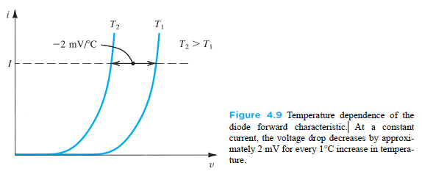
Temperature dependence of the diode forward characteristic
the voltage drop across the diode decreases by approximately 2 mV for every 1°C increase in temperature.
So diodes could be used in the design of electronic thermometers
Notes:
Since both I_{S} and V_{T} are functions of temperature, the forward i–v characteristic varies with temperature, as illustrated in Fig. 4.9. At a given constant diode current, the voltage drop across the diode decreases by approximately 2 mV for every 1°C increase in temperature. The change in diode voltage with temperature has been exploited in the design of electronic thermometers.

Slide 30
4.2.2. The Reverse-Bias Region
The reverse-bias region of operation is entered when v < 0.
I-V relationship, for negative voltages with |v| > V_{T} (25mV), is closely approximated by equations to right.

Slide 31
4.2.2. The Reverse-Bias Region
A “real” diode exhibits reverse-bias current, although small, much larger than I_{S} .
10⁻⁹ vs. 10⁻¹⁴Amps
A large part of this reverse current is attributed to leakage effects.
whereas I_{S} doubles for every 5°C rise in temperature,
the corresponding rule of thumb for the temperature dependence of the reverse current is that it doubles for every 10°C rise in temperature.

Slide 32
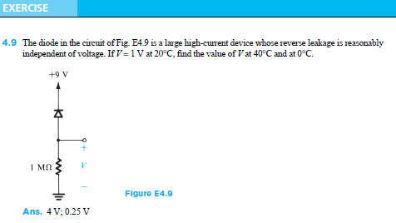
4.2.2. The Reverse-Bias Region

Slide 33
4.2.3. The Breakdown Region
The breakdown region of operation is entered when v < V_{ZK}.
Zener-Knee Voltage (V_{ZK})
This is normally non-destructive.
breakdown region
Notes:
Calculate the power dissipated to see if it is “Destructive”.
As can be seen from Fig. 4.8, in the breakdown region the reverse current increases rapidly, with the associated increase in voltage drop being very small. Diode breakdown is normally not destructive, provided the power dissipated in the diode is limited by external circuitry to a “safe” level. This safe value is normally specified on the device data sheets. It therefore is necessary to limit the reverse current in the breakdown region to a value consistent with the permissible power dissipation.

Slide 34
4.3. Modeling the Diode Forward Characteristic
We are now ready to consider the analysis of circuits employing forward-conducting diodes.
Upcoming slides, we will discuss simplified diode models better suited for use in circuit analyses:
exponential model
constant voltage-drop model
ideal diode model
small-signal (linearization) model

Slide 35
4.3.1. The Exponential Model
exponential diode model
most accurate
most difficult to employ in circuit analysis
due to nonlinear nature
Notes:
Spice simulations (as in Multisim or LTSpice) use this model.

Slide 36
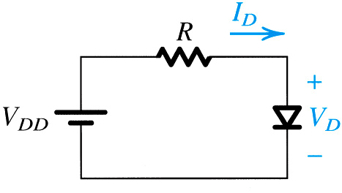
4.3.1. The Exponential Model
Q: How does one solve for I_{D} in circuit to right?
V_{DD} = 5V
R = 1kOhm
I_{D} = 1mA @ 0.7V
A: Two methods exist…
graphical method
iterative method
Figure 4.10: A simple circuit used to illustrate the analysis of circuits in which the diode is forward conducting.

Slide 37
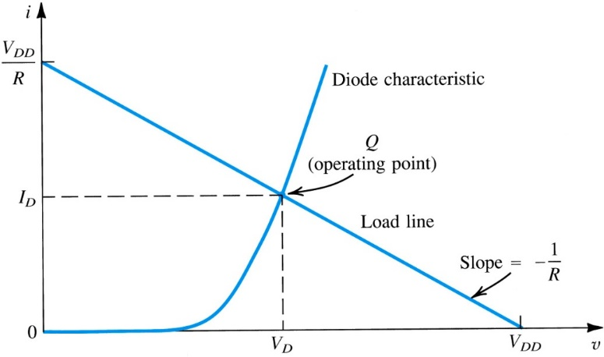
4.3.2. Graphical Analysis Using Exponential Model
step #1: Plot the relationships of (4.6) and (4.7) on single graph
step #2: Find intersection of the two…
load line and diode characteristic intersect at operating point
Figure 4.11: Graphical analysis of the circuit in Fig. 4.10 using the exponential diode model.
Notes:
Graphical solutions are a classical approach when dealing with nonlinear equations.
The load Line is determined by the linear portion of the circuit.

Slide 38
4.3.2. Graphical Analysis Using Exponential Model
Pro’s
Intuitive
b/c of visual nature
Con’s
Poor Precision
Not Practical for Complex Analyses
multiple lines required
Figure 4.11: Graphical analysis of the circuit in Fig. 4.10 using the exponential diode model.

Slide 39
4.3.3. Iterative Analysis Using Exponential Method
step #1: Start with initial guess of V_{D}.
V_{D}⁽⁰⁾
step #2: Use nodal / mesh analysis to solve I_{D}.
step #3: Use exponential model to update V_{D}.
V_{D}⁽¹⁾ = f(V_{D}⁽⁰⁾)
step #4: Repeat these steps until V_{D}^{(k+1)} = V_{D}^{(k)}.
Upon convergence, the new and old values of V_{D} will match.

Slide 40
4.3.3. Iterative Analysis Using Exponential Method
Pro’s
High Precision
Con’s
Not Intuitive
Not Practical for Complex Analyses
10+ iterations may be required
Notes:
This is a job for a computer, not a person.

Slide 41
EXAMPLE 4.4

Slide 42
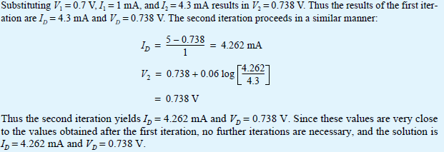
EXAMPLE 4.4

Slide 43
4.3. Modeling the Diode Forward Characteristic
The Need for Rapid Analysis
Q: How can one analyze these diode-based circuits more efficiently?
A: Find a simpler model.
One example is assume that voltage drop across the diode is constant.
Notes:
The simplest and most widely used diode model is the constant-voltage-drop model. This model is based on the observation that a forward-conducting diode has a voltage drop that varies in a relatively narrow range, say 0.6 to 0.8 V.
Accurate analysis of the almost-final
design can be performed with the aid of a computer circuit-analysis program such as SPICE (see Appendix B and the disc). The results of such an analysis can then be used to further refine or “fine-tune” the design.

Slide 44
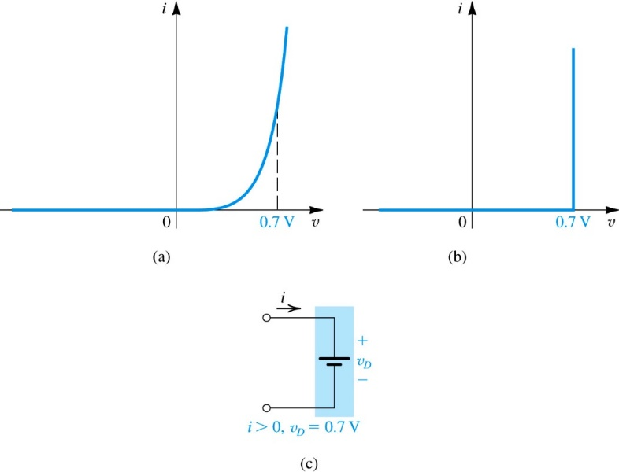
4.3.5. The Constant Voltage-Drop Model
The constant voltage-drop diode model assumes that the slope of I_{D} vs. V_{D} is vertical @ 0.7V
Q: How does example 4.4 solution change if CVDM is used?
A: 4.262mA to 4.3mA
Figure 4.12: Development of the diode constant-voltage-drop model: (a) the exponential characteristic; (b) approximating the exponential characteristic by a constant voltage, usually about 0.7 V; (c) the resulting model of the forward–conducting diodes.

Slide 45
4.3.6. Ideal Diode Model
The ideal diode model assumes that the slope of I_{D} vs. V_{D} is vertical @ 0V
Q: How does example 4.4 solution change if ideal model is used?
A: 4.262mA to 5mA
Notes:
In applications that involve voltages much greater than the diode voltage drop (0.6 V–0.8 V), we may neglect the diode voltage drop altogether while calculating the diode current.

Slide 46
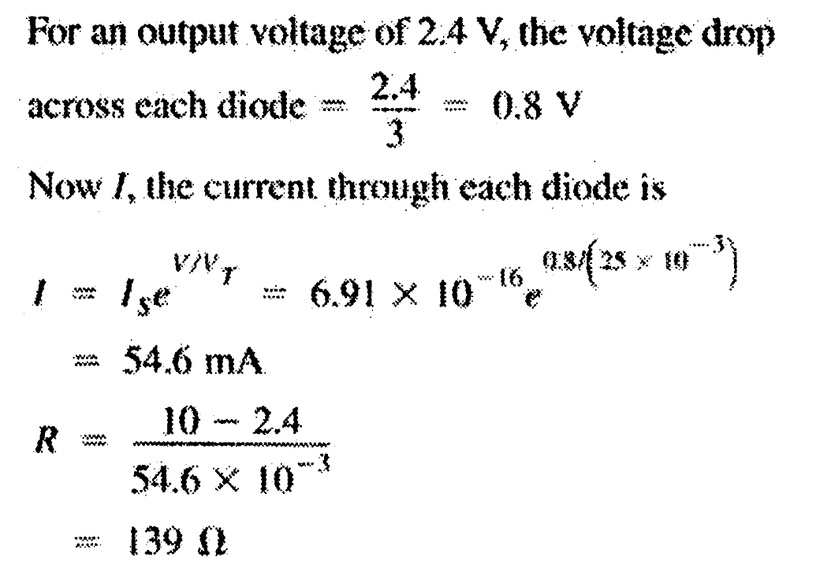
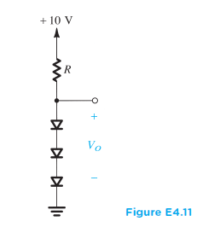
EXERCISE 4.11
Design the circuit in Fig. E4.11 to provide an output voltage of 2.4 V. Assume that the diodes available have 0.7-V drop at 1 mA.

Slide 47
When to use these models?
exponential model
low voltages
less complex circuits
emphasis on accuracy over practicality
constant voltage-drop mode:
medium voltages = 0.7V
more complex circuits
emphasis on practicality over accuracy
ideal diode model
high voltages >> 0.7V
very complex circuits
cases where a difference in voltage by 0.7V is negligible
small-signal model
this is next…

Slide 48
4.3.7. Small-Signal Model
small-signal diode model
Diode is modeled as variable resistor.
Whose value is defined via linearization of exponential model.
Around bias point defined by constant voltage drop model.
V_{D}⁽⁰⁾ = 0.7V
Notes:
There are applications in which a diode is biased to operate at a point on the forward i–v characteristic and a small ac signal is superimposed on the dc quantities. For this situation, we first have to determine the dc operating point (VD and ID) of the diode using one of the models discussed above. Most frequently, the 0.7-V-drop model is utilized. Then, for small-signal operation around the dc bias point, the diode is modeled by a resistance equal to the inverse of the slope of the tangent to the exponential i–v characteristic at the bias point.

Slide 49
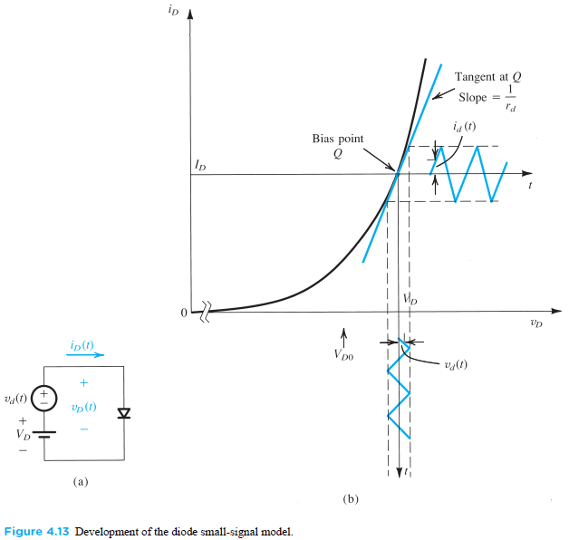
4.3.7. Small-Signal Model

Slide 50
4.3.7. Small-Signal Model
Q: How is the small-signal diode model defined?
A: The total instantaneous circuit is divided into steady-state and time varying components, which may be analyzed separately and solved via algebra.
In steady-state, diode represented as CVDM.
In time-varying, diode represented as resistor.

Slide 51
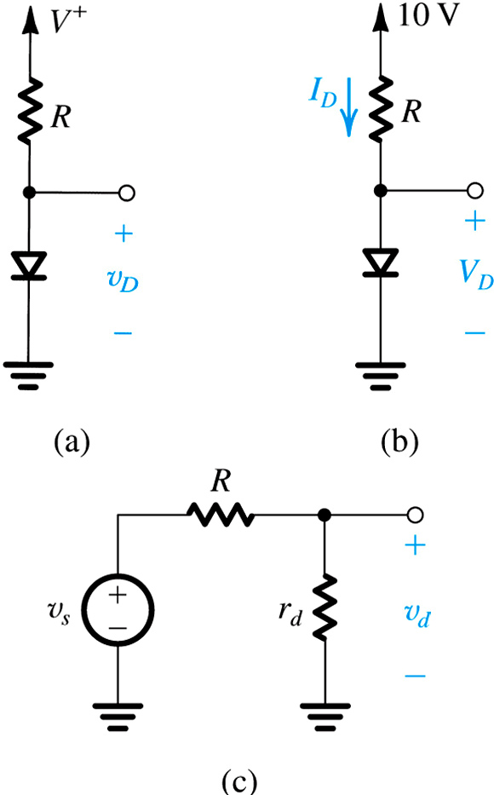
CVDM
Total Instantaneous Solution (v_{D.})
DC
Steady-State Solution (V_{D.})
DC
=
+
AC
Time-Varying Solution (v_{d.})
AC
Figure 4.14: (a) Circuit for Example 4.5. (b) Circuit for calculating the dc operating point. (c) Small-signal equivalent circuit.

Slide 52
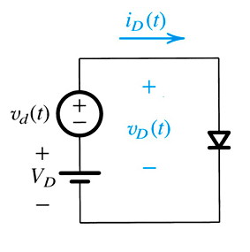
4.3.7. Small-Signal Model
Q: How is the small-signal diode model defined?
step #1: Consider the conceptual circuit of Figure 4.13(a).
DC voltage (V_{D}) is applied to diode
Upon V_{D}, arbitrary time-varying signal v_{d} is super-imposed
Notes:
This is the way to accurately analyze a nonlinear system when only small perturbations from the Operating Point are present in the system.

Slide 53
4.3.7. Small-Signal Model
DC only – upper-case w/ upper-case subscript
time-varying only – lower-case w/ lower-case subscript
total instantaneous – lower-case w/ upper-case subscript
DC + time-varying
Notes:
Nomenclature (I will try to be consistent with the text).

Slide 54
4.3.7. Small-Signal Model
step #2: Define DC current as in (4.8).
step #3: Define total instantaneous voltage (v_{D}) as composed of V_{D} and v_{d}.
step #4: Define total instantaneous current (i_{D}) as function of v_{D}.

Slide 55
4.3.7. Small-Signal Model
step #5: Redefine (4.10) as function of both V_{D} and v_{d}.
step #6: Split this exponential in two.
step #7: Redefine total instant current in terms of DC component (I_{D}) and time-varying voltage (v_{d}).

Slide 56
4.3.7. Small-Signal Model
step #8: Apply power series expansion to (4.12).
step #9: Because v_{d}/V_{T} << 1, certain terms may be neglected.

Slide 57
4.3.7. Small-Signal Model
small signal approximation
Shown to right for exponential diode model.
total instant current (i_{D})
small-signal current (i_{d.})
small-signal resistance (r_{d.})
Valid for for v_{d} < 5mV amplitude (not peak to peak).

Slide 58
4.3.7: Small-Signal Model
Q: How is small-signal resistance r_{d} defined?
A: From steady-state current (I_{D}) and thermal voltage (V_{T}) as below.
Note this approximation is only valid for small-signal voltages v_{d} < 5mV.

Slide 59
Example 4.5: Small-Signal Model
Consider the circuit shown in Figure 4.14(a) for the case in which R = 10kOhm.
The power supply V+ has a dc value of 10V over which is super-imposed a 60Hz sinusoid of 1V peak amplitude (known as the supply ripple)
Q: Calculate both amplitude of the sine-wave signal observed across the diode.
A: v_{d.}(peak) = 2.68mV
Assume diode to have 0.7V drop at 1mA current.

Slide 60
Figure 4.14: (a) circuit for Example 4.5. (b) circuit for calculating the dc operating point. (c) small-signal equivalent circuit.

Slide 61
Example 4.5: Small-Signal Model

Slide 62
4.3.8. Use of Diode Forward Drop in Voltage Regulation
Q: What is a voltage regulator?
A: Circuit whose voltage output remains stable in spite of changes in supply and load.
Q: What characteristic of the diode facilitates voltage regulation?
A: The approximately constant voltage drop across it (0.7V).
Notes:
This is NOT a great voltage regulator, but is instructive.
For instance, we have seen in Example 4.5 that while the 10-V dc supply voltage had a ripple of 2 V peak-to-peak (a ±10% variation), the
corresponding ripple in the diode voltage was only about ±2.7 mV (a ±0.4% variation).

Slide 63
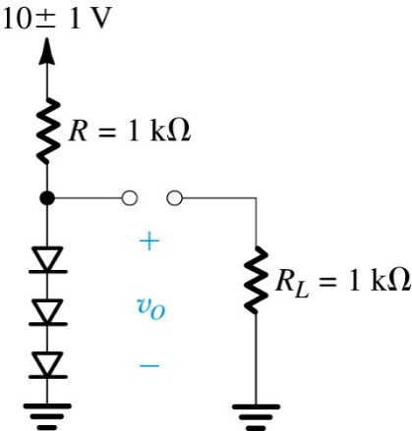
Example 4.6: Diode-Based Voltage Regulator
Consider circuit shown in Figure 4.15. A string of three diodes is used to provide a constant voltage of 2.1V.
Q: What is the change in this regulated voltage caused by (a) a +/- 10% change in supply voltage and (b) connection of 1kOhm load resistor.
Figure 4.15: Circuit for Example 4.6.
Notes:
This is a “shunt” regulator (shunts excess current from going through the load).
i.e. calculate the percentage of regulation – (Percent output change)/(Percent input change) times 100 of course.

Slide 64
Example 4.6: Diode-Based Voltage Regulator
Thus,
This resistance, along with the resistance R, forms a voltage divider whose ratio can be used to calculate the change in output voltage due to a ±10% (i.e. ±1V) change in supply voltage. Thus the peak-to-peak change in output voltage will be
That is, corresponding to the ±1-V (±10%) change in supply voltage, the output voltage will change by ±9.5 mV or ±0.5%. Since this implies a change of about ±3.2 mV per diode, our use of the small signal model is justified.

Slide 65
Example 4.6: Diode-Based Voltage Regulator
When a load resistance of 1 kΩ is connected across the diode string, it draws a current of approximately 2.1 mA. Thus the current in the diodes decreases by 2.1 mA, resulting in a decrease in voltage across the diode string given by
Since this implies that the voltage across each diode decreases by about 6.7 mV, our use of the small-signal model is not entirely justified. Nevertheless, a detailed calculation of the voltage change using the exponential model results in $∆v_{o}=−23 mV$, which is not too different from the approximate value obtained using the incremental model.

Slide 66
EXERCISE 4.14
Consider a diode biased at 1 mA. Find the change in current as a result of changing the voltage by (a) −10 mV, (b) −5 mV, (c) +5 mV, and (d) +10 mV. In each case, do the calculations (i) using the small-signal model and (ii) using the exponential model.
Solution:
For small signal model,
$$i_{D}=I_{D}+\frac{I_{D}}{V_{T}}v_{d} ⇒ ∆i_{D}=\frac{I_{D}}{V_{T}}{∆v}_{d} (1)$$
For exponential model,
$$i_{D}=I_{S}e^{\frac{v}{V_{T}}}$$
$$\frac{i_{D2}}{i_{D1}}=e^{\frac{v_{2}−v_{1}}{V_{T}}}=e^{\frac{∆v}{V_{T}}}$$
$∆i_{D}=i_{D2}$-$i_{D1}=i_{D1}e^{\frac{∆v}{V_{T}}}−i_{D1}$
$$∆i_{D}=i_{D1}{(e}^{\frac{∆v}{V_{T}}}−1) (2)$$

Slide 67
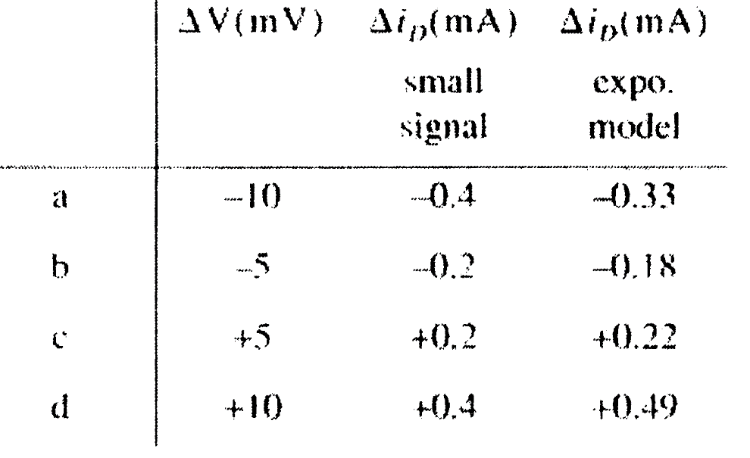
EXERCISE 4.14
In this problem, $i_{D1}=I_{D}=1 mA$
Using equations (1) and (2), where $V_{T}=25 mV$

Slide 68
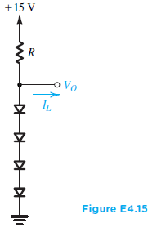
EXERCISE 4.15
Design the circuit of Fig. E4.15 so that V_{O} = 3 V when I_{L} = 0, and V_{O} changes by 20 mV per 1 mA of load current.
(a) Use the small-signal model of the diode to find the value of R.
(b) Specify the value of I_{S} of each of the diodes.
(c) For this design, use the diode exponential model to determine the actual change in V_{O} when a current I_{L} = 1 mA is drawn from the regulator.
Solution:
a) In this problem $\frac{∆V_{o}}{∆i_{L}}=\frac{20 mV}{1 mA}=20 Ω$
$$∴Total small signal resistance of the four diodes=20 Ω$$
$$∴for each diode r_{d}=5Ω=\frac{V_{T}}{I_{D}} ⇒I_{D}=\frac{25 mV}{5Ω}=5mA$$
$$∴R=\frac{15−3}{5mA }=2.4 kΩ$$

Slide 69
EXERCISE 4.15
b) For Vo = 3 V, voltage drop across each diode = 0.75 V
$$I_{D}=I_{S}e^{\frac{V}{V_{T}}} ⇒I_{S}=\frac{I_{D}}{e^{\frac{V}{V_{T}}}}=4.7×{10}^{−16}A$$
c) If $i_{D}=5−i_{L}=4 mA$
Across each diode the voltage drop is
$$V_{D}=V_{T}\ln\left(\frac{I_{D}}{I_{S}}\right)=25×{10}^{−3}×\ln\left(\frac{4×{10}^{−3}}{4.7×{10}^{−16}}\right)=0.7443 V$$
Voltage drop across 4 diodes = 4x $0.7443 V=2.977 V$
So the change in Vo = 23 mV

Slide 70
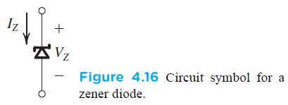
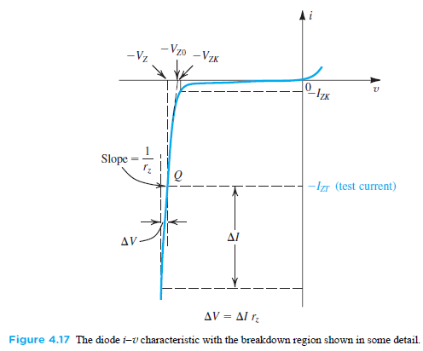
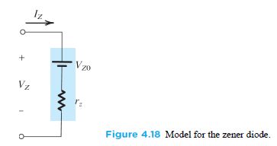
4.4. Operation in the Reverse Breakdown Region – Zener Diodes
Under certain circumstances, diodes may be intentionally used in the reverse breakdown region.
These are referred to as Zener Diodes.
Notes:
A somewhat better way to built a shunt regulator. The diode is used in reverse bias.
The very steep i–v curve that the diode exhibits in the breakdown region (Fig. 4.8) and the almost-constant voltage drop that this indicates, suggest that diodes operating in the breakdown region can be used in the design of voltage regulators.

Slide 71
Summary (1)
In the forward direction, the ideal diode conducts any current forced by the external circuit while displaying a zero-voltage drop. The ideal diode does not conduct in reverse direction; any applied voltage appears as reverse bias across the diode.
The unidirectional current flow property makes the diode useful in the design of rectifier circuits.
The forward conduction of practical silicon-junction diodes is accurately characterized by the relationship i = I_{S}e^{V/VT}.

Slide 72
Summary (2)
A silicon diode conducts a negligible current until the forward voltage is at least 0.5V. Then, the current increases rapidly with the voltage drop increasing by 60mV for every decade of current change.
In the reverse direction, a silicon diode conducts a current on the order of 10⁻⁹A. This current is much greater than I_{S} and increases with the magnitude of reverse voltage.

Slide 73
Summary (3)
Beyond a certain value of reverse voltage (that depends on the diode itself), breakdown occurs and current increases rapidly with a small corresponding increase in voltage.
Diodes designed to operate in the breakdown region are called zener diodes. They are employed in the design of voltage regulators whose function is to provide a constant dc voltage that varies little with variations in power supply voltage and / or load current.

Slide 74
Summary (4)
In many applications, a conducting diode is modeled as having a constant voltage drop – usually with value of approximately 0.7V.
A diode biased to operate at a dc current I_{D} has small signal resistance r_{d} = V_{T}/I_{D}.
Rectifiers covert ac voltage into unipolar voltages. Half-wave rectifiers do this by passing the voltage in half of each cycle and blocking the opposite-polarity voltage in the other half of the cycle.

